Slide 1
Car Identifier
Computer Science – 481
California State University, Fullerton
Aatib Abdullah
Dr. Alexander Gauf

Slide 2
Introduction
The Car Identifier System is an Expert system that is used to Identify cars by Model, Make/Brand, or Generation
It would be used in Traffic Control Systems, mainly for catching Traffic Violations such as Speeding, and crossing Red Lights
It is important to know about what Car the driver was using, since it is important as part of collecting data on traffic violators
Law Enforcement can use this system for the same purpose of Identifying cars, as part of investigating crime or suspicious activity
The system would use photos and video frames (both can be treated the same), to detection

Slide 3



Software and Tools
Tensorflow API 1.15, for Machine Learning and model training. Models provided
Anaconda Environment Distribution, incudes Conda Package Management system. Utilized in command line. Tensorflow is downloaded using Conda
Jupyter Notebook: An online web application that can be used as a compiler
Label IMG script program (explained later slides)
Packages of pillow, lxml, Jupyter(to get Jupyter Notebook), and Matplotlib
More information in Page 3 of the report

Slide 4
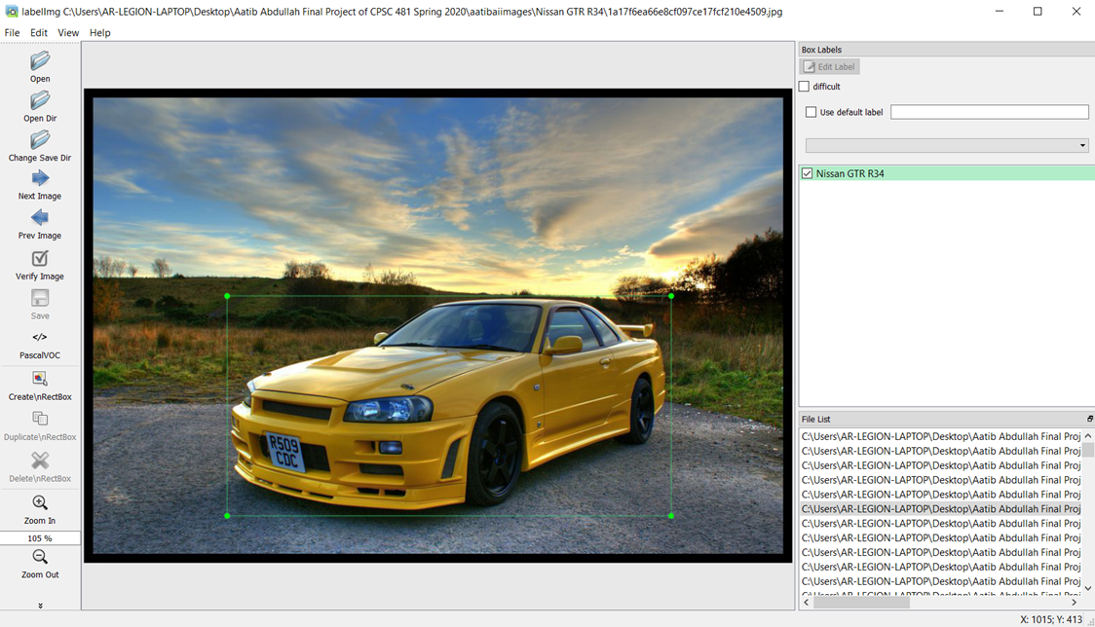
Implementation: LabelImg and Class set-up
A program can be used to put labels on Images
You draw a box around the portion where you want the training of the models to be done
The label will be the name of that box portion, which you have now a custom class
For my Project there I will use three cars as our classes: Nissan GTR R34, Nissan GTR R35, Porsche 911 992
The reason for using such vehicles because they are good examples of how to identify by different Generations( a group of model years of a car model)
Car models within same generations look similar, making detection difficult
This process is lengthy(in hours) because you would have to draw boxes for couple hundred to thousand of images
However, if you know where to draw the box it would take less time
During this process, the portion that has the box around it will be captured in an XML file that is created when making the boxes

Slide 5
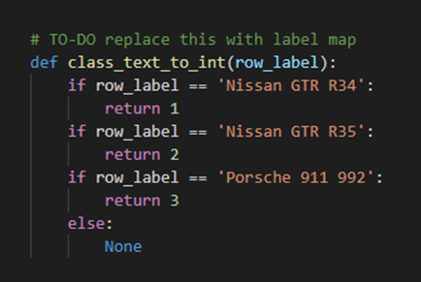
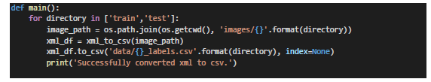

Convert XML into CSV for TFRecords
The XML files we created using LabelImg are the converted into CSV. This is done by using the Script “xml_to_csv.py”. Lines 28 to 33 is where the converted files are put into the data directory
We then use the CSV files to generate TFRecords. TFRecords are binary sequential recorsd that contain strings, regarding the data in the CSV files. We would use the script generate_tfrecords.py for to get the binary data that we would need for training. In the function of “class_test_to_int(row label)”, each class that represents a car model will return 1-3. We would have TFRecords for both Training and Testing processes.
Fig.2: Xml_to_csv.py 28-33 line
Fig.1: generate_tfrecords.py
Fig.3: generate_tfrecords.py

Slide 6
Training our Model
We now use our TFRecords data for Training. We use the configuration file “ssd_mobilenet_v1_pets.config ” in training directory of models file. We change the number of classes to 3, and lower the number of examples in the eval_config function.
We use the Train.py script, that would use our TFRecords data as input for training our TensorFlow models to detect Images. We use “Python train.py –logtostderr –train_dir=training/--pipeline_config_path=training/ssd_mobilenet_v1_pets.config” command in the model/research/object_detection directory
During Training, you can access the statistics by using the command “tensorboard --logdir CAR_IDENTIFIER\training”. You can find the graph of Total Loss, which shows how accurate can the models are becoming. The lower the Total Loss the more accurate it is. Here is the graph below of Total Loss. For the system to be accurate enough it should be close to or below 1. My case was that it was below 2 and close to 1 (1.23).

Slide 7
Testing and Exporting our Model
We the test and export our model by using the export_inference_graph.py from the object_detection directory in research file of model. We run the command below and we get our trained model “car_identifier_graph.” Car_Identifier is the main part of our program with the script to run it would be “Testing_Car_Identifier.ipynb.” This file is ran on Jupypter Notebook
python export_inference_graph.py --input_type image_tensor
--pipeline_config_pathCAR_IDENTIFIER/training/ssd_mobilenet_v1_pets.config
--trained_checkpoint_prefix CAR_IDENTIFIER /training/model.ckpt-2158
--output_directory CAR_IDENTIFIER/car_identifier_graph

Slide 8
Lets Run the system

Slide 9
Efficiency of the Algorithms
The Detection Algorithm (def run_for_single_image)in our own program is approximately O(1) which is constant time due to being used on one image each time. Although there is a for loop in the algorithm, it has a fixed element count.
The Algorithm for Outputting the Images is O(n). The variable n would represent the amount of Images in the Images directory that it would be using. This Algorithm represents a function that uses the detection algorithm to detect the objects in the Images.

Slide 10
Implementation Challenge and Learning Experience: To get more Images for Better Accuracy or Decrease Number of Examples
The amount of images you have determines the accuracy of the system. Having more images in the range of thousands can help reduce the Total loss and make it more accurate. Finding a lot of images can be a challenge because it is very lengthy process. The solution is to find about a thousand images and create new images out of them like flipping a photo form left to right orientation. One can also find more images.
If you do not have enough Images, you can decrease “num_examples”(number of examples variable) in “ssd_mobilenet_v1_pets.config” in the eval_config function (evaluation configuration function). The mistake made that I did not edit the number of examples (like about 100) and kept it at the original 1100 size. It made the system less accurate, so if one does not have enough the system would make mistakes in detection. Decreasing the number of examples in the evaluation configuration function can make the detection system more accurate if running on a low number of images. The system would train and test on that amount every step in the training process, although it would take longer because it would look at each of the images for detail.

Slide 11
Conclusion
This system will be in operation by the Beginning of December in the year of 2020. This project would help make identification of cars more easier for Traffic controllers to detect. The status of the project is that it has not been implemented yet, but it will be worked on after the release of this document. The Traffic controllers will be able to get information about a vehicle by looking at the footage of the car once this system would be in effect. This system would be able to assist Law Enforcement and Road Traffic Management to do their Jobs.

